Slide 1
TOWARDS A SUSTAINABLE MODEL FOR TOURISM PLANNING
31 March 2015
G M Makgamatha

Slide 2
CONTENTS
Background
Looking at the conditions, experiences and events influencing planning within local government
Planning relationships among sectors
Model for tourism planning
Conclusion

Slide 3
Background
Chapter 5 of the MSA provides and overarching framework integrated development planning (IDP) in municipalities
IDP represents a single, inclusive & strategic plan of a municipality that integrates planning & aligns resources & capacity of a municipality
Mainly integrates all sectoral plans to facilitate the achievement of integrated development in communities

Slide 4
Background Continued………..
To develop & implement credible IDPs that brings about integrated development, which largely depends on sound sectoral planning process

Slide 5
Planning relationships
Many municipalities struggle to develop sector plans, including tourism plans into the IDPs
Lack of integration of sectoral planning in the development process can be attributed to many factors, one being inability to identify and demonstrate relationships among various sectors

Slide 6
Planning relationships Continued…..
In most instances sector plans are normally developed as stand alone plans independent from one another ( resulting in fragmented programmes & projects that are not aligned or contributing to the vision of a municipality)

Slide 7
Model for tourism planning
SECTOR INTEGRATGION PROCESS
Logical approach need to be adopted by municipalities to follow a particular logic in the development of sector plans & that relationship between different sector plans is well understood by all stakeholders
The diagram below demonstrates how integrated approach can contribute in achieving the outcomes of developmental local government
Outline the principles to guide the development & review of sector plans including tourism plans

Slide 8
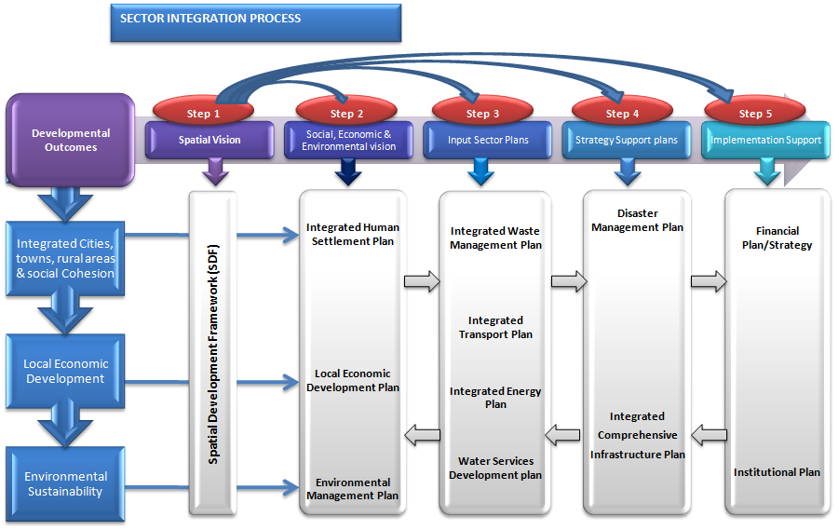

Slide 9
Sector integration process cont.…
Plans should be informed by Integrated Human Settlement Plan, LED plan & Environmental Management plan which are informed by the SDF
They are meant to provide socio-economic & transformation vision of the municipality
Sector plans should not be developed in isolation of one another, e.g. tourism plan or strategy should be developed & aligned to the LED plan or strategy of the municipality

Slide 10
Sector integration process cont.…
Plans should not be high level academic documents, but rather indicate concrete interventions relevant to a municipality
It is critical that tourism sector plan be aligned to the NDP as municipalities are at the core of the achievement of many elements of the decent standard of living advanced by the NDP
Municipalities need to plan for all the services to be provided in their space irrespective of whether they will be directly providing the service or it will be provided by other stakeholders

Slide 11
CONCLUSION
It is critical that this understanding of the direct and indirect role of the municipalities be understood by all sectors at both national and provincial level.
The department of tourism has a critical role to play in supporting municipalities to develop credible Tourism Sector Plans and review to ensure alignment & integration with other plans
The department (NDT) need to ensure that municipalities are sufficiently capacitated & that support is coordinated & integrated with efforts of other stakeholders

Slide 12
THANK YOU

